Slide 1

Machine Learning
ICT-4261
By-
Dr. Jesmin Akhter
Professor
Institute of Information Technology
Jahangirnagar University

Slide 2
Contents
The course will mainly cover the following topics:
A Gentle Introduction to Machine Learning
Important Elements in Machine Learning
Linear Regression
Logistic Regression
Naive Bayes
Support Vector Machines
Decision Trees and Ensemble Learning
Neural Networks and Deep Learning
Unsupervised Learning

Slide 3
Outline
Ensemble Learning
Notes:
https://iq.opengenus.org/cart-algorithm/

Slide 4
Ensemble Learning
Ensemble methods refer to the techniques used in machine learning to combine multiple base models to achieve better predictive performance. Rather than relying on a single model, ensemble methods aim to leverage the strengths of multiple models to create a more accurate and robust predictor.
Ensemble methods are widely used in various applications, including image classification, natural language processing, and financial market prediction. By combining multiple models, ensemble methods can help to reduce the risk of overfitting, improve the accuracy and stability of predictions, and provide a more robust and reliable predictor.
The term “model” to describe the output of the algorithm that trained with data. This model is then used for making predictions. This algorithm can be any machine learning algorithm such as logistic regression, SVM, decision tree, etc. These models, when used as inputs of ensemble methods, are called ”base models,” and the end result is an ensemble model.
It combines low performing classifiers (also called as weak learners or base learner) and combine individual model prediction for the final prediction.
On the basis of type of base learners, ensemble methods can be categorized as homogeneous and heterogeneous ensemble methods. If base learners are same, then it is a homogeneous ensemble method. If base learners are different then it is a heterogeneous ensemble method.
Notes:
Example If you are planning to buy an air-conditioner, would you enter a showroom and buy the air-conditioner that the salesperson shows you? The answer is probably no. In this day and age, you are likely to ask your friends, family, and colleagues for an opinion, do research on various portals about different models, and visit a few review sites before making a purchase decision. You would not come to a conclusion directly. Instead, you would try to make a more informed decision after considering diverse opinions and reviews. In the case of ensemble learning, the same principle applies

Slide 5
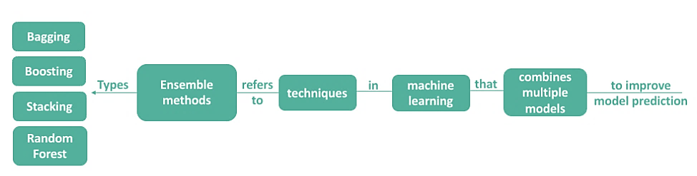
Main Types of Ensemble Methods

Slide 6
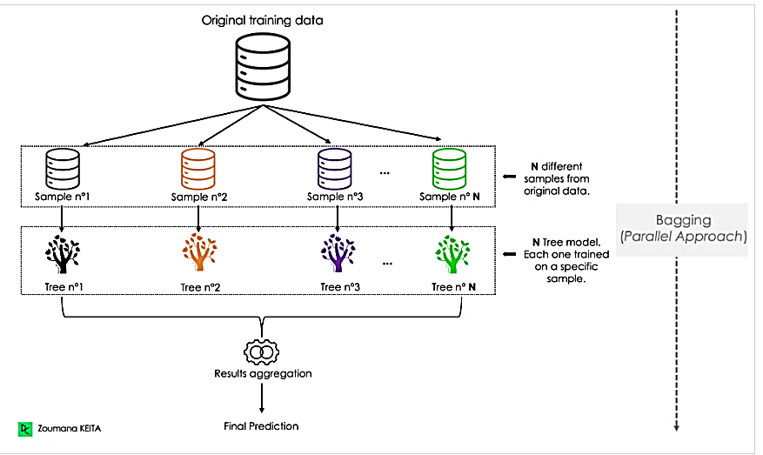
Bagging
Bagging, short for Bootstrap Aggregating, is a machine learning ensemble technique used to improve the accuracy and stability of a model. It generates multiple subsets of the training data by random sampling with replacement and then training a model on each subset. Finally, the individual models are combined by taking their predictions’ average (for regression) or majority vote (for classification).
Notes:
Bagging, stands for Bootstrap Aggregating

Slide 7
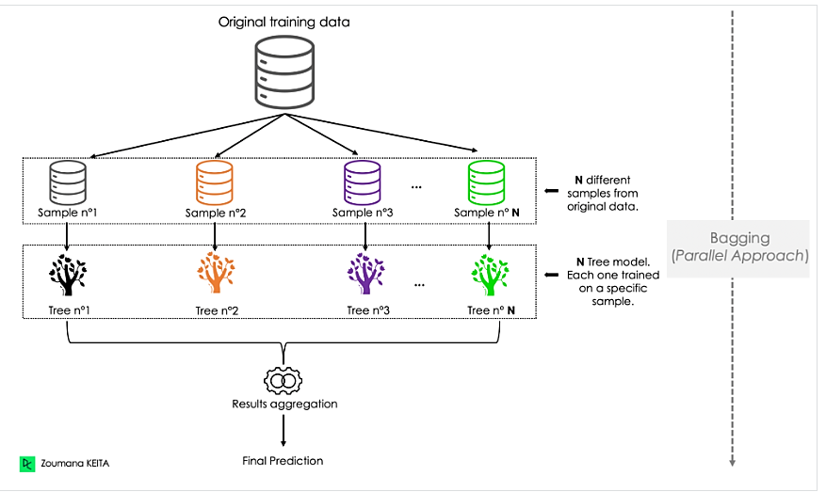
How Does Bagging Work?
Let us look at the main steps of the bagging algorithm:
Random Sampling: The training dataset is randomly sampled with replacement to generate multiple subsets, each of which has the same size as the original dataset.
Training: A separate model is trained on each subset using the same learning algorithm. Each model is trained independently, so they have different perspectives on the problem.
Aggregation: The predictions from the individual models are combined by taking the average (for regression) or majority vote (for classification) of their predictions. This produces the final prediction of the bagged model.
By combining multiple models, bagging helps reduce the model’s variance and can prevent overfitting by introducing diversity into the training process. It is commonly used with decision trees but can also be applied to other models.
One important aspect of bagging is that it requires the base model to have high variance but low bias. This means that the model should be able to fit the training data relatively well but not too tightly. Bagging can then be used to reduce the variance of the model and improve its generalization performance on new, unseen data.

Slide 8
Example #1
Suppose a data scientist is working on a project to predict whether a customer will purchase a certain product based on their demographic information and browsing history on a website. The data set consists of 10,000 customers and 50 features, and the data scientist plans to use a decision tree algorithm to build the model.
To improve the model’s accuracy and stability, the data scientist uses bagging. First, the data set is divided into subsets with 1,000 customers. Then, 25 features are randomly selected for each subset, and a decision tree is trained on that subset using only those 25 features.
Once all the decision trees are trained, their predictions are combined by taking the majority vote for each customer. If, for example, seven out of ten decision trees predict that a customer will purchase the product, then the bagged model will predict that the customer will make a purchase.
Notes:
Demographics refers to a statistical survey or study of individuals or populations describing their characteristics. Its main purpose is to help businesses understand the trends and background of the audience.

Slide 9
Advantages and Disadvantages
Bagging presents several key advantages and disadvantages when used for classification or regression tasks.
Advantages
The modeling process is straightforward and does not require any deep mathematical concepts, and can handle missing values.
The scikit-learn package makes it easy to implement the underlying logic. It contains all the modules to combine the predictions of each model, also known as base learners.
Bagging helps to reduce the model’s variance and can prevent overfitting by introducing diversity into the training process.
Bagging provides an unbiased estimate of the out-of-bag error, which corresponds to the average error/loss that all these classifiers yield.
Bagging is important because it can improve the accuracy and stability of a model, particularly when dealing with high-dimensional data or noisy samples.
Disadvantages
Bagging is computationally expensive due to the use of several models.
The averaging involved across predictions makes it difficult to interpret the final result.

Slide 10
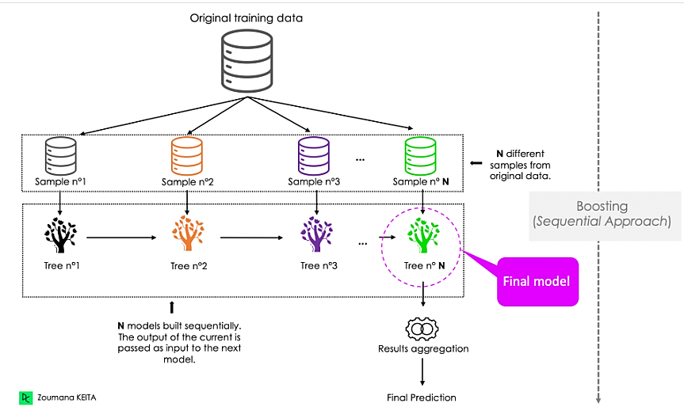
Boosting
Boosting adopts a sequential approach, where the prediction of the current model is transferred to the next one. Each model iteratively focuses attention on the observations that are misclassified by its predecessors. We’ve outlined the general process below:

Slide 11
Advantages and Disadvantages
Advantages
Similarly to bagging, boosting is easy to understand and implement. Furthermore, it does not require any preprocessing and can handle missing values in the data.
It efficiently reduces bias.
Boosting algorithms prioritize features that increase overall accuracy during the training. This process reduces the dimensionality of the data, hence reducing the computation time.
Disadvantages
The sequential approach of boosting makes the next models correct the mistakes of its predecessor. This makes the overall model vulnerable to outliers.
Boosting is not scalable for the same reason as the sequential aspect.

Slide 12
Bagging | Boosting
Combines multiple models by averaging (for regression) or majority voting (for classification) | Combines multiple models by boosting the weights of misclassified instances
Each model is trained independently, with no influence on the other models | Each model is trained sequentially, with each subsequent model trained to correct the errors of the previous model
Reduces variance by introducing diversity in the training process | Reduces bias by improving the accuracy of the model in difficult instances
Helps prevent overfitting by reducing variance | This can lead to overfitting if the models are too complex or the learning rate is too high.
Works best with models that have high variance but low bias | Works best with models that have low variance but high bias

Slide 13
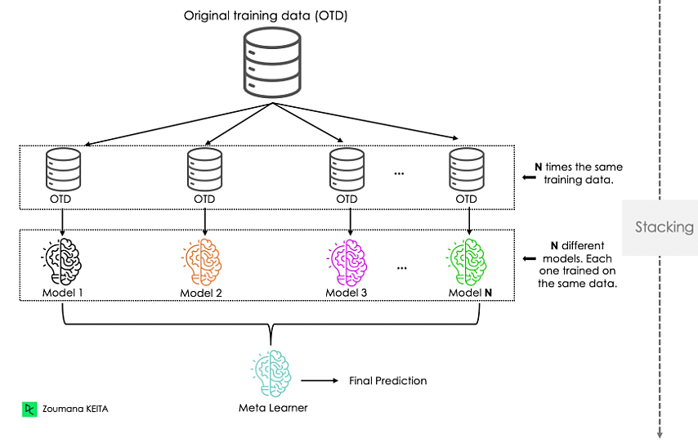
Stacking
Stacking is pretty similar to boosting. The predictions from the base learners are stacked together and are used as the input to train the meta learner to produce more robust predictions. The meta learner is then used to make final predictions. Bagging and boosting typically use homogeneous base learners, whereas stacking tends to include heterogeneous ones.

Slide 14
Advantages and Disadvantages
Advantages
It leverages the strengths of multiple high-performing models for both classification and regression tasks.
Similar to other ensemble models, stacking helps build a more accurate model than individual models used alone.
Disadvantages
Using complex basic models can increase the risk of overfitting.
Different levels of a model’s training can make the stacking architecture complex to implement.

Slide 15
Voting
In voting, multiple models are trained independently, and their predictions are combined to make a final prediction using either hard voting, soft voting, or weighted voting:
In hard voting, the final prediction is the most common prediction from all the models.
For soft voting, each model generates a probability distribution instead of a binary prediction. Then, the class with the highest probability is the one predicted.
Finally, in weighted voting, there is an assumption that some models have more skill than others and those models are assigned with more contribution when making predictions.

Slide 16
Advantages and Disadvantages
Advantages
Voting architecture is simple to implement compared to stacking, and blending. Also, it does not require complex fine-tuning.
Using multiple base learners in the voting makes it less susceptible to the influence of individual models, which contributes to making more stable and reliable predictions.
Disadvantages
It can be difficult to deal with models’ prediction conflict, which makes it hard to make the final decision in a meaningful way.
Adding more models to the ensemble voting model does not necessarily improve the final performance.

Slide 17
Cascading
Cascading uses a stacking approach but with only one model in each layer. The first model is trained on the whole training data, and the next model is trained on the output of the model before. The goal of using the strategy is to learn complex patterns from the data, hence allow the model to make better predictions.
Advantages
The next model is specialized in the output of the previous model, which reduces noise in the data.
More robust to overfitting and can perform well on real-world data.
Disadvantages
Implementing the cascading can be complex since it involves training each of the modes in the sequence.
Getting the optimal cascading architecture can require a lot of experimentation and fine-tuning.

Slide 18
Bagging | Random Forest
A machine learning ensemble technique used to improve the accuracy and stability of a model | A machine learning algorithm that uses Bagging to improve the accuracy and stability of decision trees
Involves generating multiple subsets of the training data by random sampling with replacement | Involves generating multiple decision trees on bootstrapped subsets of the training data
Used in machine learning to reduce variance by introducing diversity in the training process | Used in machine learning to reduce variance and overfitting in decision trees
Involves training a separate model on each subset using the same learning algorithm | Involves training multiple decision trees on bootstrapped subsets of the data, with random feature selection
Combines the predictions of the individual models by taking the average (for regression) or majority vote (for classification) of their predictions | Combines the predictions of multiple decision trees by taking the majority vote (for classification) or the average (for regression) of their predictions

Slide 19
Ensemble Learning
Advantages | Disadvantages
Can improve the accuracy+ and robustness of predictions | It can be computationally expensive and require more resources
Can reduce overfitting and improve generalization | It may be more difficult to interpret or explain the model
Can combine strengths of multiple models to overcome weaknesses | It may require careful tuning of hyperparameters
It can be used with a variety of machine-learning algorithms | It can introduce bias or errors if individual models are flawed
Can improve the stability of predictions in the face of noisy or uncertain data | It may not always lead to significant improvements in performance
It can be applied to a variety of tasks and applications | It may not be suitable for small or simple datasets

Slide 20
Sample Questions
1. Is bagging random forest?
Random Forest is an ensemble method that uses bagging as its main component. It generates multiple decision trees on different subsets of the training data and combines their predictions using averaging or majority voting.
2. How does bagging reduce variance?
Bagging reduces variance by introducing diversity in the training process. By generating multiple subsets of the training data and training a separate model on each subset using the same learning algorithm, Bagging helps reduce individual samples’ impact on the final model. This helps to prevent overfitting and improve the model’s generalization performance by reducing the impact of outliers or noisy samples on the final prediction.
3. Does bagging increase bias?
Bagging typically does not increase bias in a model, as it uses the same learning algorithm on each subset of the training data. However, it can reduce variance and overfitting, which may lead to a slightly increased bias-variance trade-off.

Slide 21
Thank You

